Slide 1
Visual Simulation
03: Higher level system construction

Slide 2
Learning Objective
To understand the rational concerning the design of higher level rendering systems

Slide 3
As we have seen
Visualisation is a wide ranging domain with many applications
  While these are very different
  All require the same basic processes
    Data loading
    Rendering
    Animation & Simulation
    Interaction & Selection

Slide 4
As we have seen
OpenGL is a very powerful toolkit
  Sequential set of instructions that are processed on the Graphics Card
    Very fast
However, OpenGL was originally driven by the design of the hardware
  Optimized to deliver instructions that can efficiently drive the GC
Not by the requirements of the application domain

Slide 5
Practical consideration
OpenGL is a very small API
  @25 key functions
    Anyone can learn these in a few days
However
  Interplay between these
  Efficient use
  Understanding the operation of hardware and software
  3D theory and approaches
All require much deeper understanding
  To become expert in OpenGL and its application takes much longer
    At least 2 years of experience

Slide 6
Practical Consideration
OpenGL is very low level
  Most engineers, programmers, etc just want to display a 3D environment
  More interested in the
    Interaction
    Simulation
    Navigation
While OpenGL is very powerful it is too low level and technical for most application developers
Need some form of middleware

Slide 7
So what the requirements of the application domain?
Generic
  Many different applications
  All defined by a a similar set of data
    Geometry
    Transformations
    Attributes
  Ideally we would like to be able to load data and display simply
Extensible & re-useable
  New application of visualisation are constantly emerging
    Any solution must be able to adapt to the new forms of data and requirements
    Any new components should be re-usable for subsequent applications
Representative
  The semantics of the data should reflect the application domain, not the instruction set

Slide 8
So, how do we start
Look at our data and instructions and try to define a classification
  We have seen that we have
    Drawing instructions
      Primitives
      Lights
    Transformations
      Projection
      Model
    Attributes
      Rendering state
      Material
      Environmental conditions
        Fog
        Light propagation
    And a few others
      We’ll leave these for the time being

Slide 9
Geometry
Defined by data
  Arrays of
    Co-ordinates -> verticies
    Normals
    Texture mapping (text coords)
  Construction type
    Triangles, tri-strip, tri-fan, etc
And by function
  Rendering
    OGL functions to ‘draw’ the primitive
  Change and modification of the data

Slide 10
Lights
Defined by data
  Lighting parameters
    Position & orientation
    Light emission
    Light propogation
  State
    On or off
And by function
  Rendering
    OGL functions to ‘draw’ the light
  Change and modification of the data

Slide 11
Transformations
Defined by data
  Matrix
And by function
  Rendering
    OGL functions to ‘apply’ the transformation
  Change and modification of the data
Also must consider that these are cumulative & that must manage the transformation stacks
  Therefore also need to be able to provide an ordered list of transformations

Slide 12
Attributes
Defined by data
  Parameters
  State
    On or off
And by function
  Rendering
    OGL functions to ‘apply’ the attribute
  Change and modification of the data
Also must consider that these are cumulative & that must manage the attribute stack
  Therefore also need to be able to provide an ordered list of attributes

Slide 13
Semantics
While the first two classes define data components
The latter two define semantic structures
  Their effects are cumulative
  The arrangement of these defines the semantics of the data
    This is a structure based on determining common states and spatial properties of the data
      Eg: consider a room

Slide 14
We could
Transforms
Attributes
Maintain two lists of these objects
  Transformations
  Attributes

Slide 15
We could
Transforms
Attributes
Maintain two lists of these objects
  Transformations
  Attributes
Then try to link the data components to this

Slide 16
However
This will soon become un-manageable
  Too many relationships
How do we know what order objects should be applied in
  Precedence and cumulative actions
This gets us no closer to reflecting the application domain

Slide 17
Consider
If we combine these two semantic data types into a single tree structure
  Traversing each arm allows us to cumulatively apply the states
  Manage many differing states

Slide 18
Consider
We can also attach the ‘drawable’ objects into this structure
  Now as we traverse down from the top
    The state for each drawable is defined by the route taken to get to it

Slide 19
Consider
We are also collecting together ‘drawable’ objects based on similarities in both attribute and spatial arrangement
  Consider how this works for the real world

Slide 20
Therefore
We can define this data system as a tree structure
  Leaves define ‘drawable’ objects
  Branches define semantic structure
There is some commonality here we can exploit

Slide 21
Branches
All branches may contain both
  Other branches
  Leaves
There for may define a node type
  Class
  Maintains a list of children nodes
    addChild()
    removeChild()
    getNumberOfChildren()
    getChild()
  Has an awarness of a parent
    getParent()
  Also maintains a list of leaves
    Some systems do not distinguish between leaves and branches
    On those that do these are refered to in many ways
      ‘Drawables’
      Geometry nodes -> ‘Geodes’
      Etc
    Also provide functionality for accessing these

Slide 22
Branches
Most common specialisation of a node is likely to be a group
  Collection of other nodes
    And leaves
Further specialisations are common
  Transform
  Switch
  LOD
  etc
Node
Group
Geode
Transform
Switch
LOD

Slide 23
Leaves
Leaves define a tangible section of drawable information
  And all the associated states and attributes necessary to render them
While a single general definition is possible
  Most systems encapsulate data into more specialised classes
    The leaf node is then a collator of information
      And and entry point into the drawable data

Slide 24
Leaves
Typically a leaf node may contain
  Geometric data
    Verticies
    Normals
    Texture coordinates
  Rendering states & attributes
    Colour
    Material
These are generally related by association
  Allows re-use
    Data can be associated to more than one drawable
Geode
Drawable
V Array
N Array
T Array
Material
attrbutes

Slide 25
Why, if only one type of draw able, to be have an inheritance relationship
Extensibility
  May want to define different geometry and drawing types
    Most common is polygon based
    But are many others
      CSG
      Parametric Surfaces
      Volumetric Data
This construct allows use to define a new drawing type
  That can be included into the general structure

Slide 26
Finally
We have looked at this approach for defining and retaining a scene description
  How does it help render such structures

Slide 27
Common approach
We can create a basic visitor class
  We will talk more about this later in the course
  This enacts a downward traversal of the structure
    Calling functionality to apply the data at each node
      Rendering
      Data management
      Animation
      Simulation synchronisation

Slide 28
Why go to all this bother?
What we have done is reasoned out a rational form for managing and rendering 3D data in a consistent manner
  This applies the OO principles of
    Data encapsulation
    Specialisation
      Inheritance
    Association & Aggregation

Slide 29
The end result
We have a system that is
  Generic
  Reusable
  Extensible
  Reflective of the application domain
These systems are common in Computer Graphics
  They are referred to as Scene Graphs

Slide 30
Our choice of Scene Graph

Slide 31
Learning Objective
To understand the rational for choosing a particular scene graph
What is the basic structure of our choice

Slide 32
Some History
Scene Graphs have existed since the early 1990’s
  Originally each graphics developer wrote and maintained their own
  However
    These soon became massive undertakings
      Scene Graphs are hugely large and complex systems
Silicon Graphics Inc.
  Released the original, commercial SG system
    Inventor
      New concept. People had never paid for a SG system before
      However, saved time and increased productivity
    Soon followed by
      Optimizer -> For real-time applications
      Performer -> For Engineering applications
      + many other commercial systems

Slide 33
However
No developer has ever found a way to make money from a Scene Graph library
  Development costs are massive
    Means developer licenses must be very expensive
      Therefore, even though companies may make a lot of money from the applications they sell
        They are not prepared to buy the toolkit
SGI: Bankrupt by 2005
Now most SGs are open source systems supported by a web community
  Leading ones are
    Open Scene Graph (OSG)
      European consortium
    Open Scene Graph (OpenSG)
      US consortium

Slide 34
Requirements
Ideally our Scene Graph should be
  Flexible
    Large range of different ways to handle and manage data
  Efficient
    Fast and optimized rendering
  Widely supported
    Active community of developers
    Good documentation
    Widely used
      Shows general acceptance
    Good on going development
      Frequent releases and updates
      Expanding set of features and functionality
  Free
    Open source with no restrictions on use

Slide 35
OpenSG v OSG
OpenSG
  Advantages
    Strong user base
      Small numbers but mostly commercial users
    Advanced features for supporting large scale display systems
  Disadvantages
    Poor File IO functionality
    Very Unix based -> difficult to compile and use on many platforms
    Few and infrequent updates
OSG
  Advantages
    Many Users
      Academics, Commercial organisations, etc
    Many application domains
      See examples on website
    Strong File IO
    Regular updates and revisions
  Disadvantages
    Lacks some of the features for large scale visualisation centres

Slide 36
Choice
For these reasons we will be using OpenScene Graph
  OSG
Documentation, binary distributions and source code available from
  http://www.openscenegraph.org/

Slide 37
OSG

Slide 38
OSG
OSG is built as a collection of libraries
  Based on OpenGL
Main OSG library provides the basic node structure for managing scene descriptions
osgUtil provides utility functions
  Mainly for file IO with importer/exporters defined as plugins in the osgDB library
osgGA provides windowing functions and functionallity for accessing input devices, eg Mouse and keyboard
osgViewer provides a windowing and application framework for building applications.
Nodekits define different libaraies adding extended features to the basic system
  osgFX – special effects
  osgParticle – particle systems
  osgSim – simulation
  osgVolume – medical volume rendering
  Etc
osgIntrospection is a framework for supporting cluster based rendering for large scale display systems
osgIntrospection
Node Kits
osgDB
osgGA
osgUtil
osg
OpenGL

Slide 39
Practicalities
Each library is defined by a set of classes that encapsulate a set of functionality
  Can either use classes directly or inherit from them to create your own more specialised classes
Need to instantiate to use
  Must include header file for the class
    Eg #include <osg/Node> - note NO .h
  Must link to the library to compile the code
    Add library to the linker instructions
      Eg osg.lib
  All classes are defined within the name space of the library
    Therefore must use scope resolution to access them
      Eg osg::Node *pNode=new osg::Node();

Slide 40
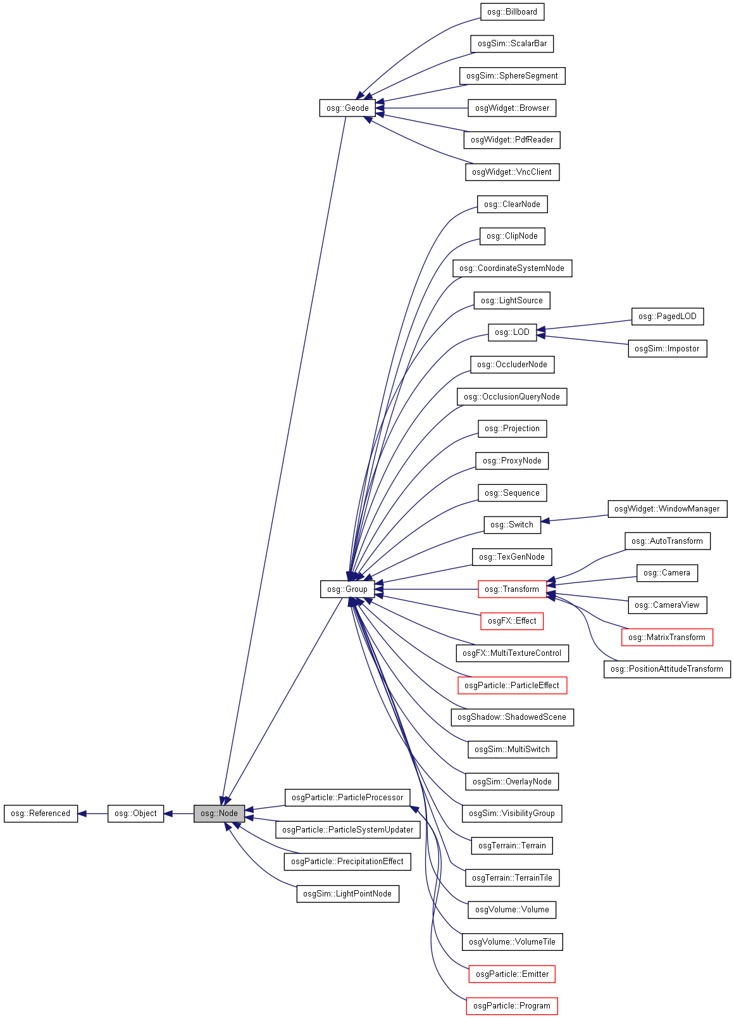
Osg Core Library
Used to define the data structure to be drawn
Mostly based on the osg::Node
  Two main Types
    osg::Group
      Sematic structure nodes
        Allow us to organise data
    osg::Geode
      Geometric data
      The actual draw-able elements

Slide 41
Osg core library
Also includes some additional classes for helping organise information
  Key ones are
    osg::Vec*
      A vector class
        Data storage
        Methods for mathematical operations
      Type depends on name end
        Eg osg::vec3f (3 floats) etc
    osg::Matrix*
      A matrix class
        Data storage
        Methods for mathematical operations
      Type depends on name end
        Eg osg::Matrixf – standard 16 float transformation matrix

Slide 42
Use
A scene description is created from a set of instantiated and populated nodes arranged in a hierarchic structure
  A group node is usually used as the place holder for the scene
myRoot (osg::Group)
transform1 (osg::MatrixTransform)
transform2 (osg::MatrixTransform)
geom1 (osg::Geode)
transform3 (osg::MatrixTransform)
animSwitch (osg::Switch)
geom2 (osg::Geode)
animTrans1 (osg::MatrixTransform)
animTrans2 (osg::MatrixTransform)
geom3 (osg::Geode)
geom4 (osg::Geode)

Slide 43
Use
Transformation nodes allow placement of geometric features
  Define a transformation relative to their parent
    Stored as a matrix
myRoot (osg::Group)
transform1 (osg::MatrixTransform)
transform2 (osg::MatrixTransform)
geom1 (osg::Geode)
transform3 (osg::MatrixTransform)
animSwitch (osg::Switch)
geom2 (osg::Geode)
animTrans1 (osg::MatrixTransform)
animTrans2 (osg::MatrixTransform)
geom3 (osg::Geode)
geom4 (osg::Geode)

Slide 44
Use
Geodes add draw-able geometry to the scene
  Each Geode references a collection of draw-able objects and defines the current rendering state for that object
    Rendering state can be colour/material, normals, texture etc
myRoot (osg::Group)
transform1 (osg::MatrixTransform)
transform2 (osg::MatrixTransform)
geom1 (osg::Geode)
transform3 (osg::MatrixTransform)
animSwitch (osg::Switch)
geom2 (osg::Geode)
animTrans1 (osg::MatrixTransform)
animTrans2 (osg::MatrixTransform)
geom3 (osg::Geode)
geom4 (osg::Geode)

Slide 45
Use
Switch nodes allow you to control the traversal route
  Can be set to allow traversal to
    All children
      Acts as a group
    No children
      Acts as a block to traversal
    Any one child
      Useful for animation
myRoot (osg::Group)
transform1 (osg::MatrixTransform)
transform2 (osg::MatrixTransform)
geom1 (osg::Geode)
transform3 (osg::MatrixTransform)
animSwitch (osg::Switch)
geom2 (osg::Geode)
animTrans1 (osg::MatrixTransform)
animTrans2 (osg::MatrixTransform)
geom3 (osg::Geode)
geom4 (osg::Geode)

Slide 46
Use
Note: a node may have multiple parents.
  However this can cause problems
    Knowing how and when to delete a node (more on this later)
    Cyclic parentage
    Confusing traversal routes
  But it is useful. In this case for reducing the geometric instances
  Use sparingly
myRoot (osg::Group)
transform1 (osg::MatrixTransform)
transform2 (osg::MatrixTransform)
geom1 (osg::Geode)
transform3 (osg::MatrixTransform)
animSwitch (osg::Switch)
geom2 (osg::Geode)
animTrans1 (osg::MatrixTransform)
animTrans2 (osg::MatrixTransform)
geom3 (osg::Geode)
geom4 (osg::Geode)

Slide 47
How do we do this in code
  Instantiate all the objects you need
  Then add the nodes together as children
osg::Group *pMyRoute=new osg::Group();
osg::MatrixTransform *pTrans1=new osg::MatrixTransform();
osg::MatrixTransform *pTrans2=new osgMatrixTransform();
pMyRoute->addChild(pTrans1);
pMyRoute->addChild(pTrans2);

Slide 48
Some of this code looks a bit odd?
The scene graph is a dynamic structure
  Do not know size or form at the time we write the application
  May also change during the application
  Therefore we have to create dynamic memory objects for it
    Note the use of the ‘new’ operator
      new osg::MatrixTransform();
  This returns a memory address to the newly instantiated class.
    We therefore need to store this address, rather than name the variable – note the * operator
      osg::MatrixTransform *pTrans1=new osg::MatrixTransform();
  When we want to use this object we can either pass the memory address to a function
    pMyRoute->addChild(pTrans1);
    However, in this case we also need to access a method defined by the class osg::Group
      Therefore have to use the -> operator to indicate that we want to access the dynamic memory object and note the memory address

Slide 49
So how do we delete an object
Unlike Java, C++ has no garbage collection
  We must actively delete any memory objects we create
As we have seen an object may have one, or many references to it
  When to delete is not always apparent.
Most modern SG, OSG included, use a simple mechanism
  Reference counting
    Whenever a reference is made to an object in the SG tree the counter, an internal variable, is incremeted
      Eg adding to the SG structure as a child
    Whenever the object is removed from the tree this counter is decremented
      When it returns to zero the object is deleted
  However, this may mean that the object we are using is deleted without us knowing while we are using it.
    Unless we also use the reference counting mechanism

Slide 50
Reference counting
OSG supports two approaches
  Smart Pointers
    An evolving feature that is often difficult to manage
  Explicit functions
    Simple operations to manage the reference count.
The key is to only use these for objects we want to keep a persistent reference to.
  Consider our simple 3 node tree
    The root node is one we always need to access
When we create the root node we need to increment the reference count
We do not need to do it for the transform nodes
  In this case, although we may need to if we are animating them.
When we are finished with the root node (at the end of the application) we should reduce the reference count
  This will allow the node to be deleted when necessary
    And any nodes it also references
osg::Group *pMyRoot=new osg::Group();
pMyRoot->ref();
osg::MatrixTransform *pTrans1=new osg::MatrixTransform();
osg::MatrixTransform *pTrans2=new osgMatrixTransform();
pMyRoute->addChild(pTrans1);
pMyRoute->addChild(pTrans2);
.
.
.
.
pMyRoot->unref();

Slide 51
Another complication
By default all nodes in OSG are created as static nodes
  The data they contain cannot be changed after it is first set.
    This allows optimization of the rendering functions
  To modify data at run-time (eg change a matrix in a matrix transform) we but explicitly set that node to a dynamic state.
In some cases you may also need to ‘dirty’ the node to force an update.
  Use the documentation to identify these nodes
osg::MatrixTransform *pTrans1=new osg::MatrixTransform();
pTrans1->ref();
osg::Matrixf m;
m.makeTranslate(osg::vec3f(10.0f, 0.0f, 0.0f));
pTrans1->setMatrix(m);
//node is static so any changes will be ignored
pTrans1->setDataVariance(osg::Object::DYNAMIC);
osg::Matrixf m2;
m2.makeTranslate(osg::vec3f(20.0f, 10.0f, 0.0f));
pTrans1->setMatrix(m2);
pTexture->dirty();

Slide 52
Application Structure

Slide 53
Now that we have created a scene tree how do we use it
We could write our own code to traverse the tree and call the render operations for each node.
  However, this is a big task
OSG provides a simple viewer class that provides an application framework
  osgViewer::Viewer
    Manages rendering transversals and much more
      Event traversals -> responses to input events
      Update traversals -> enacting simulation and animation behaviour
      Optimization traversals -> refining and reducing the SG
      Culling traversals -> reducing the actual rendering commands based on what is visible

Slide 54
How does this work
Single Threaded
  Operates in a single execution loop
Multi-threaded
  Most traversals occur in parallel
  Except rendering which must be done in the base execution thread
Event Traversal
Update Traversal
Event Traversal
Update Traversal
Optimization Traversal
Cull Traversal
Optimization Traversal
Cull Traversal
Render Traversal
Render Traversal

Slide 55
What are the implications
While the actual execution method is invisible to us there is one important consideration
  We must hand over control to the Viewer
    Therefore cannot programme code to directly access the devices
      Need to use a mechanism that works within the Viewer framework – Handlers and Manipulators
        Abstract base classes that that allow us to create our own derived classes that can pick up events and actions and respond to them.

Slide 56
Finally

Slide 57
Putting it all together
osg::Group *pMyRoot=new osg::Group();
pMyRoot->ref();
// create viewer
osgViewer::Viewer viewer;
// enable navigation
viewer.setCamera(new osgGA::TrackballManipulator());
// add own handler -> see example next week
viewer.addHandler(new myEventHandler());
// associate the scene with the viewer
viewer.setSceneData(pMyRoot);
//initiate the viewer
viewer.realize();
// hand over control
viewer.run();
Once we have created the scene graph
  Either programmatically, or by reading a file
Need to associate it with a viewer
Add tools to help us interact
Hand control over to the viewer

Slide 58
Conclusion

Slide 59
Have covered a lot today
For the next hour finish tinkering with your OpenGL app
You may also want to look at the MscVisSim project to see the source code in it
For the next session
  Go to the OSG website
    Familiarize yourself with the site
    Look at the documentation section
      Particularly the Reference Guides
www.openscenegraph.org

